Slide 1
STOCK PREDICTION USING THE REGRESSION MODEL AND MACHINE LEARNING MODELS
Presented by:
Namratha Jonnalagadda
HarshaVardhan Jonnalagadda
Thushar Mohan G
Preksha Reddy

Slide 2
Stock prediction:
To estimate predicted earnings, stock analysts must forecast sales and growth. Security research includes projected income and growth rates, which are crucial elements and frequently determine a stock's future value. For instance, a company will fetch multiples higher than the current market multiple if it exhibits a high rate of growth over consecutive periods.
A company's stock price ought to rise in response to an increase in its forward multiple, increasing investors' returns. Numerous inputs, some derived from quantitative data and others from more arbitrary sources, are needed when making forward projections. The forecasts are driven by the data's dependability and accuracy.
There are different methods of stock predictions from the historical data of the chart. The different stock prediction models involves:
1.Regression Model
2. Machine Learning Models

Slide 3
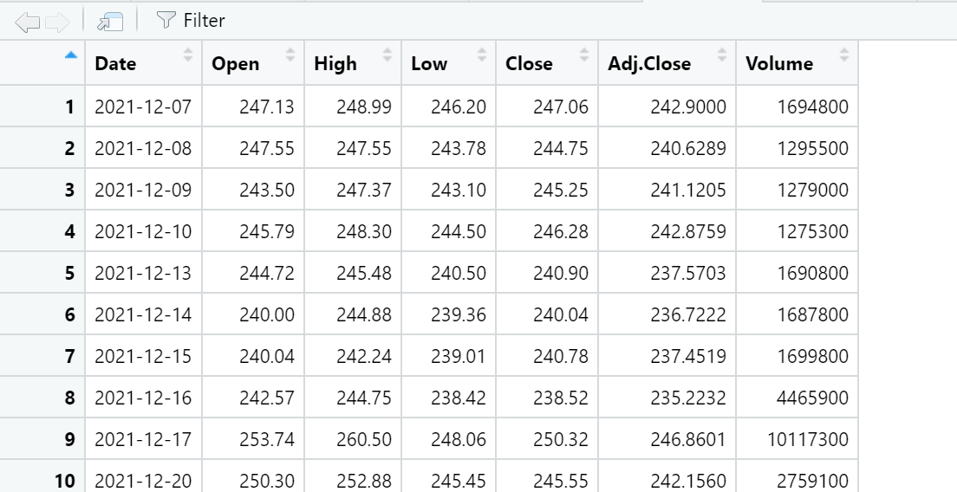
DATASET:
The stock data of the Fedex (FEDX) for the past two years is collected from the yahoo finance website.
This data consists of the six columns representing the Open, Close, High, Low, Volume, Adj Close values of the stock on each day.

Slide 4
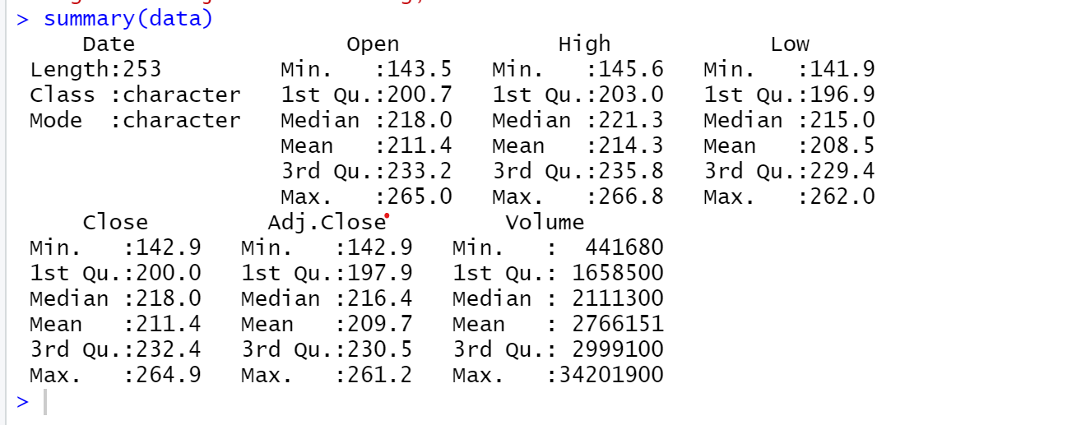
Summary of the data:

Slide 5
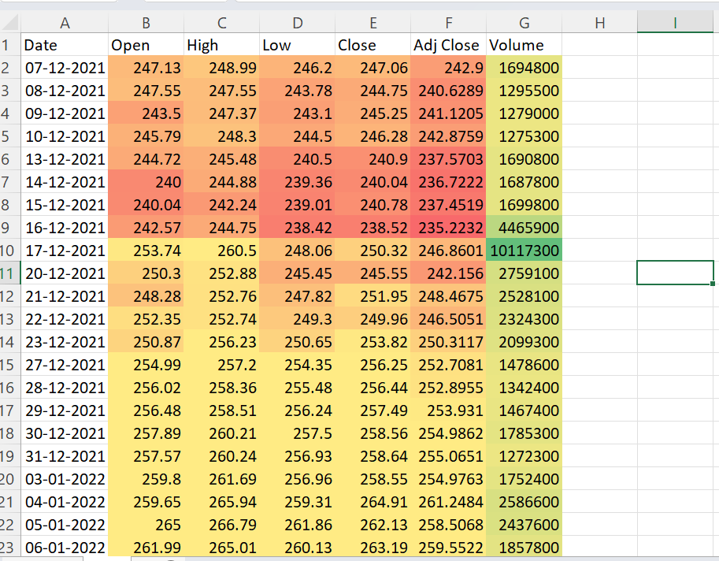
Heat Map Representing the stock data:

Slide 6
The Time series Graph of the Average FEDX Stock Value :

Slide 7
The Time series Graph of the Closing value fedx Stock :

Slide 8
Stock Forecasting using the prophet Regression Model:
Time series analysis is a technique for examining and understanding how datasets behave over time. By displaying the time series item on the graph, it also aids in learning how the dataset behaves. It is simple to accomplish in R programming by utilizing the ts() function, which accepts a data vector and turns it into a time series object according to function arguments.
Facebook created Facebook Prophet as a tool for predicting time series items or data. By predicting prices, sales, or weather, businesses can use this information to understand how their products will behave. Facebook Prophet is a tool that enables you create more precise predictive models by using decomposable models, such as trend, seasonality, and holidays.

Slide 9
The mathematical equation of the Prophet model:
y(t) = g(t) + s(t) + h(t) + e(t)
Here,
g(t) refers to the trend.
s(t) represents seasonality
h(t) represents the holiday of forecasting
e(t) refers to the error term.

Slide 10
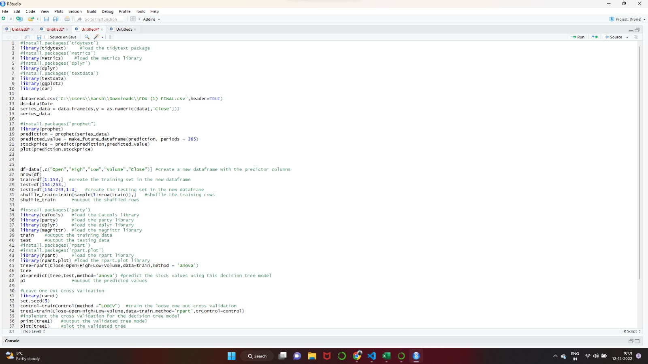
CODE:

Slide 11
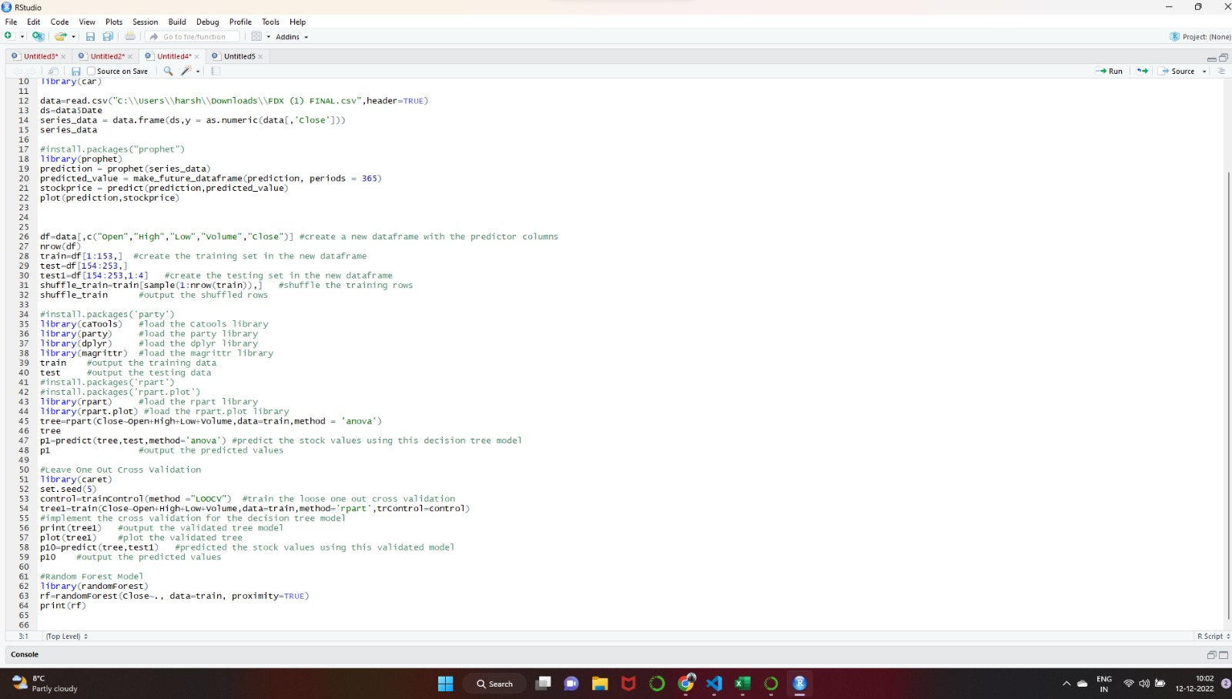
CODE:

Slide 12
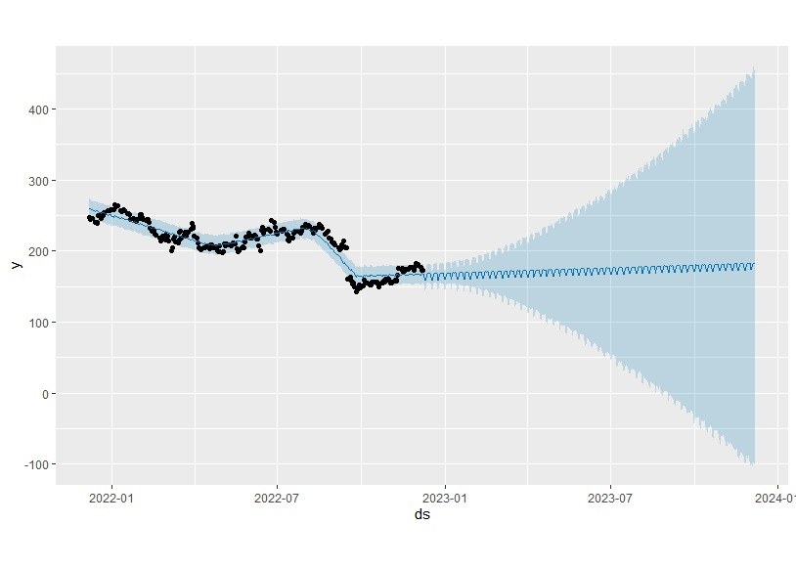
Stock Forecasting using the Prophet Regression Model:
Ds= date
Y=stock value

Slide 13
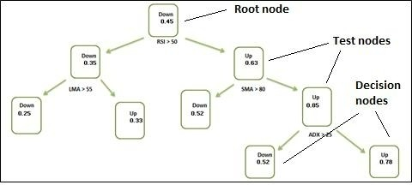
Stock Forecasting Using the Machine Learning Models:
One of the trickiest challenges in machine learning and applied AI is the prediction of stock prices.
Machine learning is the general term for a class of
algorithms that attempt to extract hidden information
from historical data and solve the problems of prediction
or classification. At present, the research of machine
learning in stock prediction mainly focus on two key
aspects.
Decision Tree:
Decision Trees are versatile Machine Learning algorithm that can perform both classification and regression tasks. They are very powerful algorithms, capable of fitting complex datasets. Besides, decision trees are fundamental components of random forests, which are among the most potent Machine Learning algorithms available today
DECISION TREE

Slide 14
LOOSE ONE OUT CROSS VALIDATION:
In a cross-validation method known as LOOCV (Leave One Out Cross-Validation), each observation is treated as the validation set, while the remaining (N-1) observations are treated as the training set. One observation validation set is used in LOOCV to fit the model and predict. Additionally, doing this for every observation as the validation set N times.
A model is fitted, and it is then utilized to forecast an observational value. In this particular instance of K-fold cross-validation, K equals N, meaning there are the same number of folds as observations. Bias and randomness are lessened by using this strategy. The technique seeks to prevent overfitting and lower the Mean-Squared error rate. LOOCV is really simple to carry out.

Slide 15
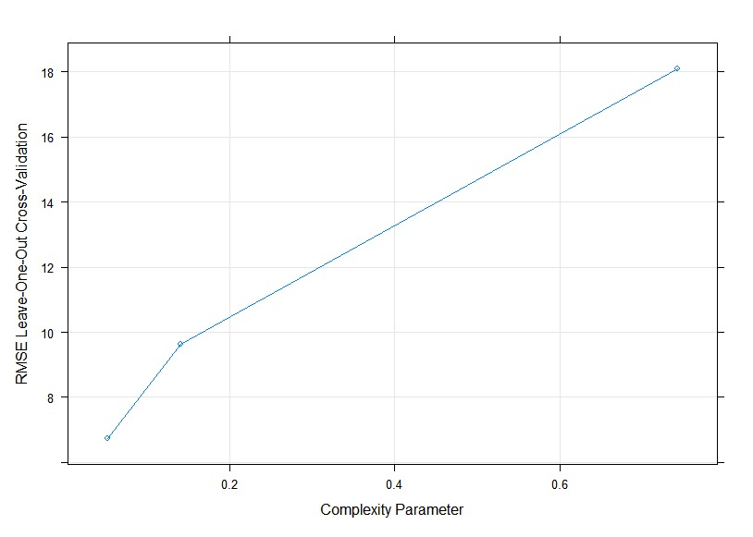
LOOSE ONE OUT CROSS VALIDATION ON THE DECISION TREE:

Slide 16
CONCLUSION:
So we can see from prophet regression model that there is an increase in the stock value over the period of time.
a decision tree algorithm executes a series of recursive operations, and when you plot these operations on a screen, the visual appears to be a large tree
Stock price = Dividend / ( i-g )
g(t) + s(t) + h(t) + t = y(t) { prophet regression }

Slide 17


